Slide 1

Mathematical modelling for vaccine-preventable diseases
Epidemiology lecture 2
SIR models with demography
Katy Gaythorpe
School of Public Health
Imperial College London
k.gaythorpe@imperial.ac.uk
Notes:
Introduce who we are

Slide 2
Objectives of this lecture
Be familiar with how demography (births, deaths and aging) is incorporated into models
Know:
the implicit assumptions in basic SIR models and when these assumptions are important
some methods for including age structure in models
how to calculate R0 for age structured populations

Slide 3
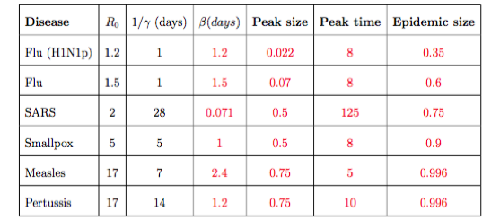
Practical

Slide 4
When does an epidemic die out?
When it runs out of fuel
Notes:
Need to change these slides

Slide 5
But what happens then…?

Slide 6
SIR model with births and deaths
Susceptible
(S)
Infected
(I)
Recovered
(R)
births
deaths
deaths
deaths
Notes:
In the absence of infection births will enter the susceptible class

Slide 7
SIR model with births and deaths
Susceptible population is topped up by births
Immune population is depleted by deaths
…until…

Slide 8
SIR model with births and deaths
Another epidemic!

Slide 9
Equations
b = birth rate (per capita)
Births
S
Infection
I
Recovery
R
m = death rate (per capita)
Deaths
Deaths
Deaths
N = S + I +R
Population size:
➔ If birth rate = death rate, dN/dt = 0
➔ Constant population size

Slide 10
Dynamics in detail
New threshold

Slide 11
Dynamics in detail

Slide 12
Dynamics in detail
Number of infected people decreasing while susceptible population is replenished

Slide 13
Dynamics in detail
The number of susceptibles starts increasing:
number of births > (number of deaths + new infections)

Slide 14
Dynamics in detail
Number of infected starts increasing again because

Slide 15
Steady state
… and you eventually reach an equilibrium (or steady state)
Epidemics get smaller
Endemic disease
Notes:
Equilibrium values

Slide 16
In the SI phase plane
Proportion infected
Proportion susceptible

Slide 17
Steady state
Business as usual !!
Births
S
Infection
I
Recovery
R
Deaths
Deaths
Deaths
S is constant:
I is constant:
R is constant:
Births
S
Infection
Infection
I
Recovery
Recovery
R
Deaths
Deaths
Deaths
Births = deaths + infections
Infections = deaths + recoveries
deaths = recoveries

Slide 18
Steady state solutions
What is the number of cases at steady state?
1
2
3

Slide 19
Oscillations leading to steady state…
Measles case reports in London in the pre-vaccine era (courtesy A. Conlan)
Oscillations are still driven by the delay between infections and births
Notes:
Equilibrium values

Slide 20
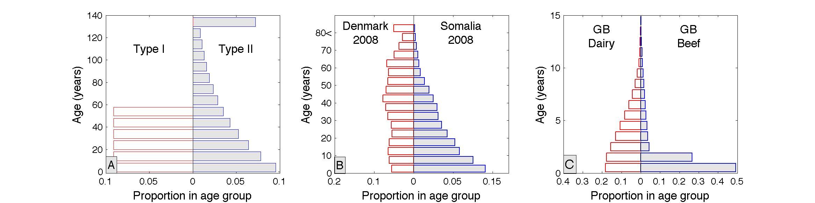
Assumptions in the standard SIR model
1. Mortality
Human populations
UK cattle population

Slide 21
Mortality
Constant risk (m) of death at each time step
Solve…
Survival function

Slide 22
Mortality vs Epidemic timescales
Survival function
Survival function

Slide 23
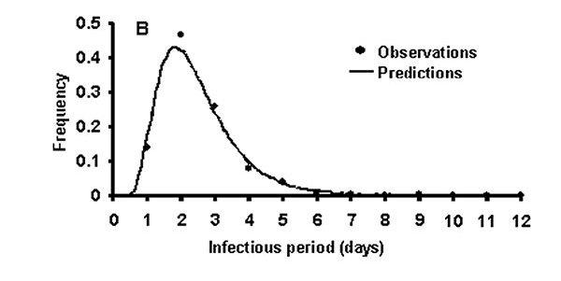
Recovery
Constant risk of recovery at each time step
Solve…
Infectious period distribution

Slide 24
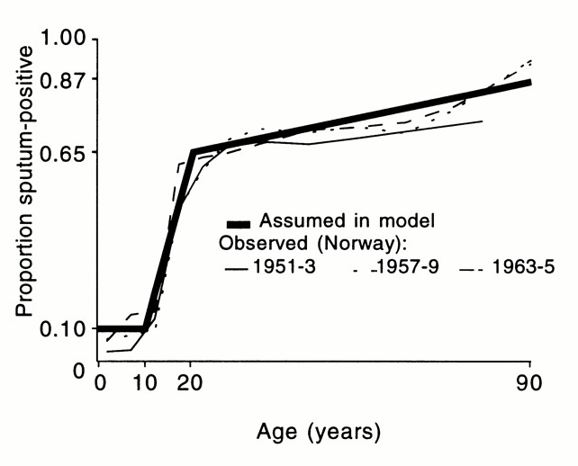
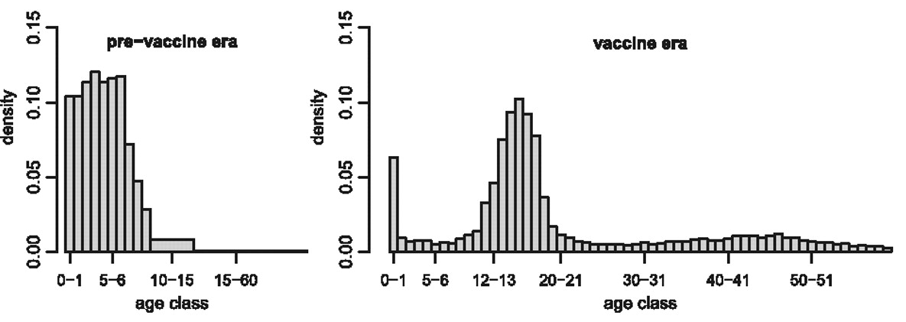
Risk of infection
Tuberculosis
Pertussis
Nardone et al. (2008)
Lavine, King, Bjornstad (2011)
Notes:
Childhood diseases (measles, rubella, pertussis) vs diseases which mainly affect adults

Slide 25
When are these assumptions important? What can I do about them?
Small populations
Persistence and fade-out
When individuals don’t complete the infection process
E.g. high risk of death before recovering
Early stages of an epidemic
Exponential distributions can misestimate R₀ in outbreak data
Biological differences by age
One age group dominates dynamics
Controls
Age-specific control options (like vaccination or school closures)

Slide 26
When are these assumptions important? What can I do about them?
Investigate alternative distributions
Build age explicitly into your model

Slide 27
Quick solution… add in multiple infectious states
Susceptible
(S)
Infected
(I)
Recovered
(R)
Susceptible
(S)
Infected
(I₁)
Infected
(I₂)
Infected
(I₃)
Recovered
(R)

Slide 28
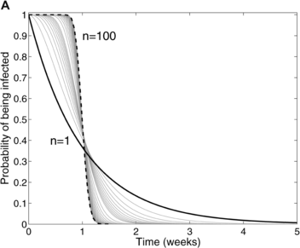
Quick solution… add in multiple infectious states
Γ distribution
Wearing, Rohani, Keeling (2005) Appropriate Models for the Management of Infectious Diseases. PLoS Med 2(7): e174.

Slide 29
Including age explicitly
Functions of time and age
Original SIR equations
Partial derivatives

Slide 30
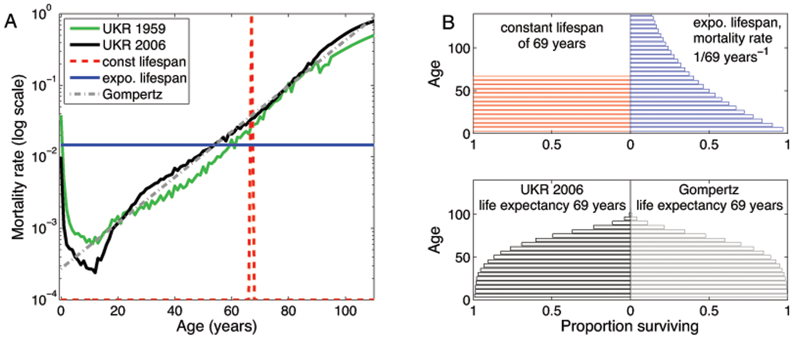
Including age explicitly
Aging modelled as a continuous process
Include age-specific mortality, susceptibility, recovery…
Notes:
Mixing between age groups

Slide 31
Discrete age groups
Mathematically simpler, but
N age groups = 3N equations!
Individuals are born (age group 0) susceptible

Slide 32
Useful distributions for lifetimes
Constant lifetime:
No chance of early death or late survival
Gompertz distribution:
Probability of death increases exponentially with age
Fit magnitude and shape parameters to data
Does not capture childhood mortality

Slide 33
Useful distributions for infectious/incubation periods
Gamma distribution
Shape parameter, k
Scale parameter, theta
→ A generalised exponential function

Slide 34
Incidence rate by age
What is ?

Slide 35
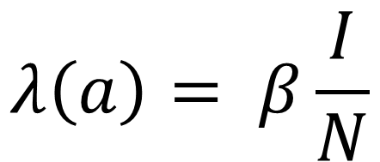
Age-specific force-of-infection
Option 1: (same for all age groups)
All age groups in contact with each other
As original SIR case
$$λ\left(a\right)= β\frac{I}{N}$$

Slide 36
Age-specific force-of-infection
Option 2: Individuals only in contact with people/animals of the same age
No transmission between age groups
Epidemic might not take off

Slide 37
Age-specific force-of-infection
Option 3: Mixing between age groups at varying rates
Transmission rate from age group b to age group a
Fraction of age group b that is infectious

Slide 38
Transmission matrix
Four age groups. Transmission within own age group only.
Two groups. Transmission between groups only.

Slide 39
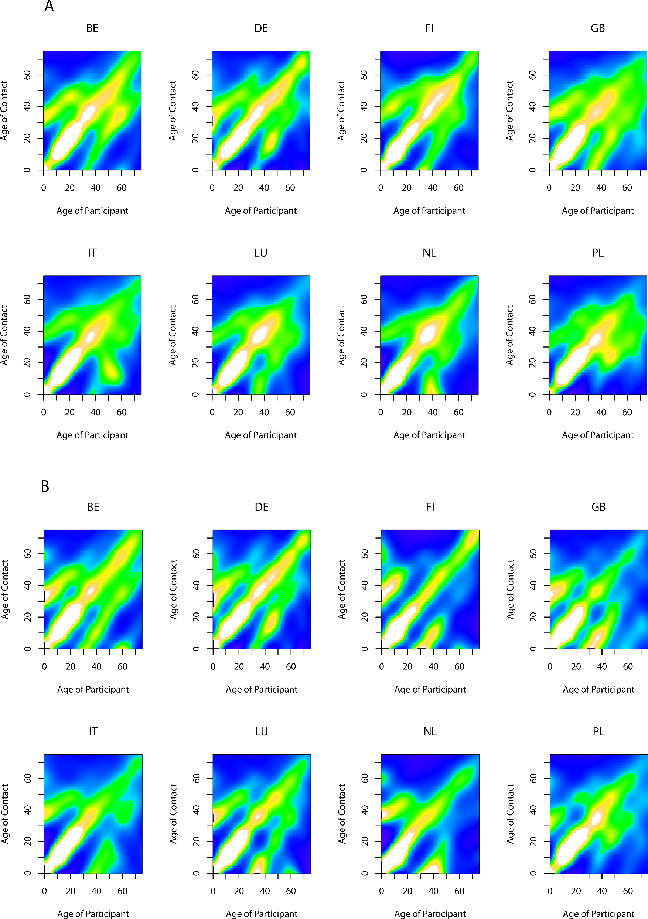
Transmission matrix
Social contacts (humans)
Within farm contacts (cattle)

Slide 40
Example: CoMix
CoMix report 2

Slide 41
What is R₀ in a structured population?
2
0.25
0.5
1.25

Slide 42
Early behaviour…
It looks like the numbers are tending to something just bigger than 2
“The average infected person produces ~2+ secondary cases”

Slide 43
Summary
Incorporating births and deaths can result in endemic infections
Oscillations are driven by the delay between infections and births
Be careful when epidemic and demographic timescales are similar
Age structured models are useful for
Including age-specific risks
More detailed demographic structure
Steady state no longer simple functions of R₀
R₀ can be calculated using eigenvalue analysis

